Slide 1

Low rated movies distribution
QIU Sha
QIN Jiali
CHEN Weizhou
ZHAO Feier 55035408

Slide 2
1
|
Background
Why we do the research on Douban&IMDb
2
|
Bad Movies on Douban
Perhaps beyond your imagination
CONTENTS
3
|
Bad Movies on IMDb
Trust me, Chinese movies are not the worst
4
|
Conclusion
A long way to go, for Chinese movie industry

Slide 3
1
1
|
Background

Slide 4


Background
WeChat
Does China have more bad movies than other countries?
Is it just a complain or Chinese movie rally fall behind other countries?

Slide 5


Bad Movies Worldwide
Domestic
Foreign

Slide 6
2
2
|
Bad movies on Douban

Slide 7
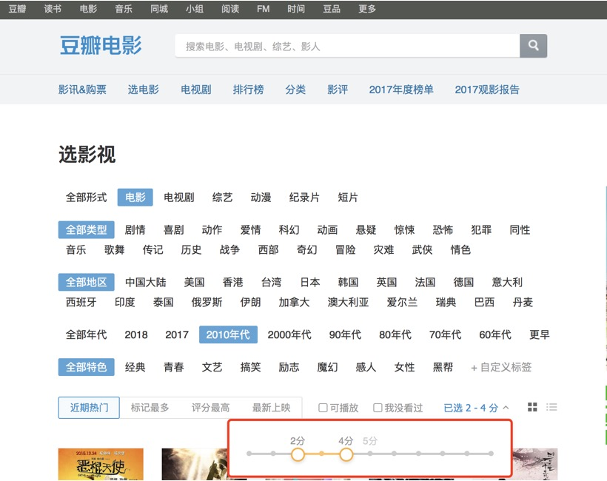
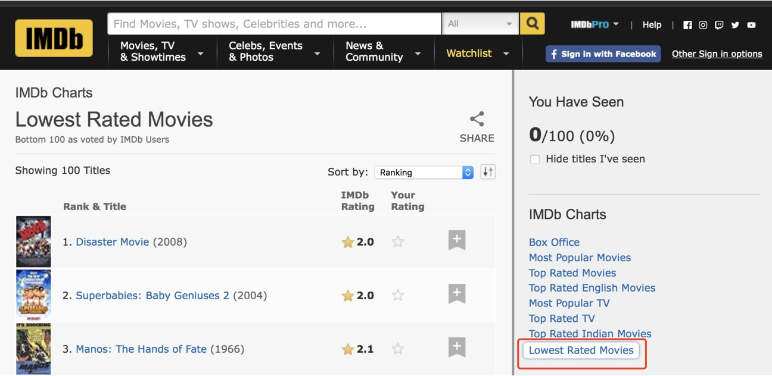
Data Range
Between 2013—2017 year
Between 2—4 points

Slide 8


Slide 9
Our Data
1
2
3
Data Collection
Data Processing
Visualization
· Range Setting
1) Rate
2) Years
· Select All 2010s
· load the webpage
Hardest
· Remove Duplicates
· Arrange Data in Order
· By Excel
· Other Tools

Slide 10
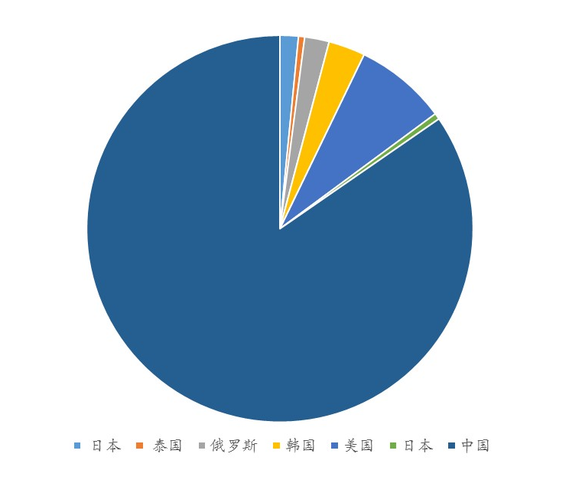
Our Data
Countries Distribution
China
Take a lead in world bad movies output.
America
Account for second large percentage
Korean/Japan/Russia
similar percentage
What do we find?

Slide 11
Our data
Year trend
trend
peak
lowest point
Upside trend
2017
2014
The number of bad movies keep increasing in recent years
2017 reach a peak point
2009 &2014 share the same numbers

Slide 12
Our data
Genres Distribution
overall
top
lowest point
distribution
comedy
suspense
Comedy ,plot and action movies rank top 3 in bad movies output
Suspense , cartoon and magic movies are more acceptable by audience
1.Human nature to watch amused movies
2.Too much production
3. Low threshold
The whole amount of suspense movies
production are small

Slide 13
3
3
|
Bad Movies on IMDb
Trust me, Chinese movies are not the worst

Slide 14


ABOUT IMDB
IMDb is
Internet Movie Database(IMDb)
The world's largest movie database
28
28 years history
Launched in 1990 and has been a subsidiary of Amazon.com since 1998.
250
250 million items
A searchable database of more than 250 million data items.
4
4 million movies, TV and entertainment programs
The world's most popular and authoritative source for movie, TV and celebrity content.
8
8 million cast and crew members
Including directors, writers, actors and other staff.

Slide 15
ABOUT IMDB
The formula for calculating the Top Rated 250 Titles gives a true Bayesian estimate (贝叶斯估计方法):
weightedrating(WR)
=(v÷(v+m))×R+(m÷(v+m))×C
R = average for the movie (mean) = (Rating)
v = number of votes for the movie = (votes)
m = minimum votes required to be listed in the Top 250
C = the mean vote across the whole report
For the Top 250, only votes from regular voters are considered.
IMDb is
Internet Movie Database(IMDb)
The world's largest movie database

Slide 16



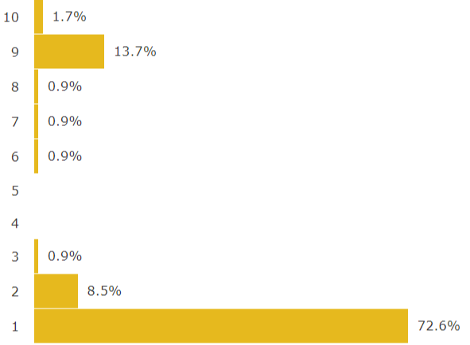

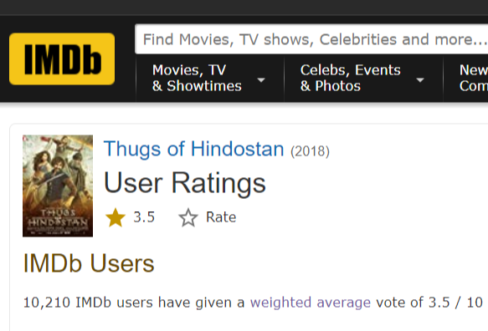

DATA RANGE
Years
Rate
1 - 4
Below the median
2013-2017
Same period
compared to Douban

Slide 17
OUR DATA
1
2
3
Data Collection
Data Processing
Visualization
· Range Setting
1) Rate
2) Years
· Select All Genres
· Web Scraping
Hardest
· Merge Files
· Remove Duplicates
· High-frequency Word
· Arrange Data in Order
· By Python
· By Excel
· Other Tools

Slide 18
WORST IN WORLD
WHY?
2969 BAD MOVIES
Other Counrties: 2846
China: 123 (including HK&TW)
Believe it or not, perfomance of Chinese movies is not the worst.

Slide 19
5-YEAR TREND
CHINA
ALL COUNTRIES
Can we say that Chinese movies perform better than before?
An overall rise in the total number.
Bad Movies Released in Recent 5 Years

Slide 20
5-YEAR TREND
GENRES OF BAD MOVIES
Not easy to scare westerners
Perhaps westerners love horror movies but hate trash horror.
Are romance movies less porpular in western countries?
It's hard to draw a conclusion.
Don't try to make people laugh
Amusing people may be the the toughest job in the world.
Cultural Difference still exists
It could be found among Douban and IMDb users.
* Each movie may has several tags of genre.

Slide 21
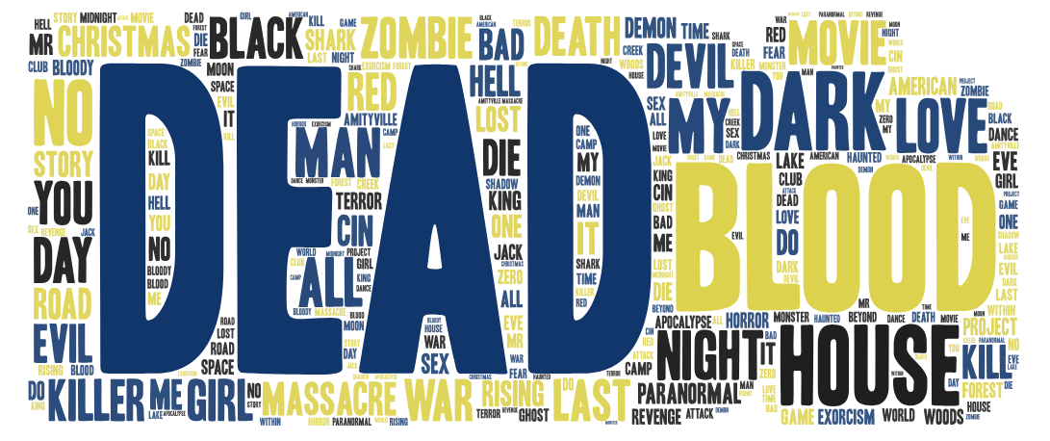
CURSE OF DEAD
Bad Movies Commonly Use The Word “Dead” in Titles

Slide 22
4
4
|
Conclusion
Chinese movie industry has a long way to go.

Slide 23
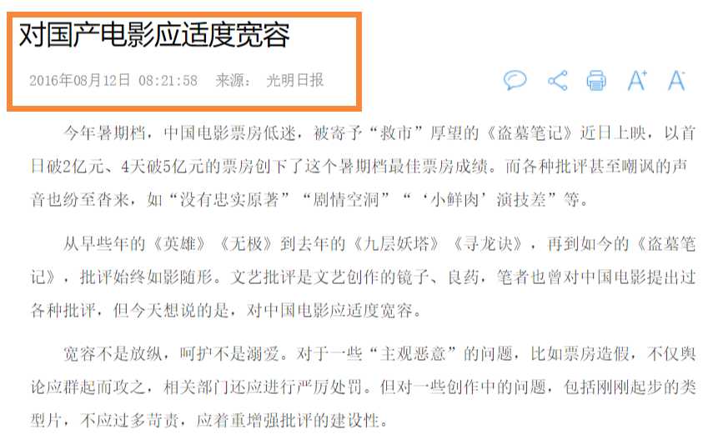

Conclusion
Admit Shortcomings
Recognize the gap between China and the west,
Chinese Movies Are Not So Bad
Bad movies come out every year.
“ Made in China” is not the worst.
Be Patient to The Growth
It will be a long and painful process.
But it is worth waiting for.

Slide 24
THANKS

